Slide 1
Fantasy of EGYPT
An ancient amusement park for you to enjoy and have fun~~~~~~~~
0~5year-old : FREE
5~19year-old: 1000NT$
Adults : 1500NT$
The senior : FREE

Slide 2
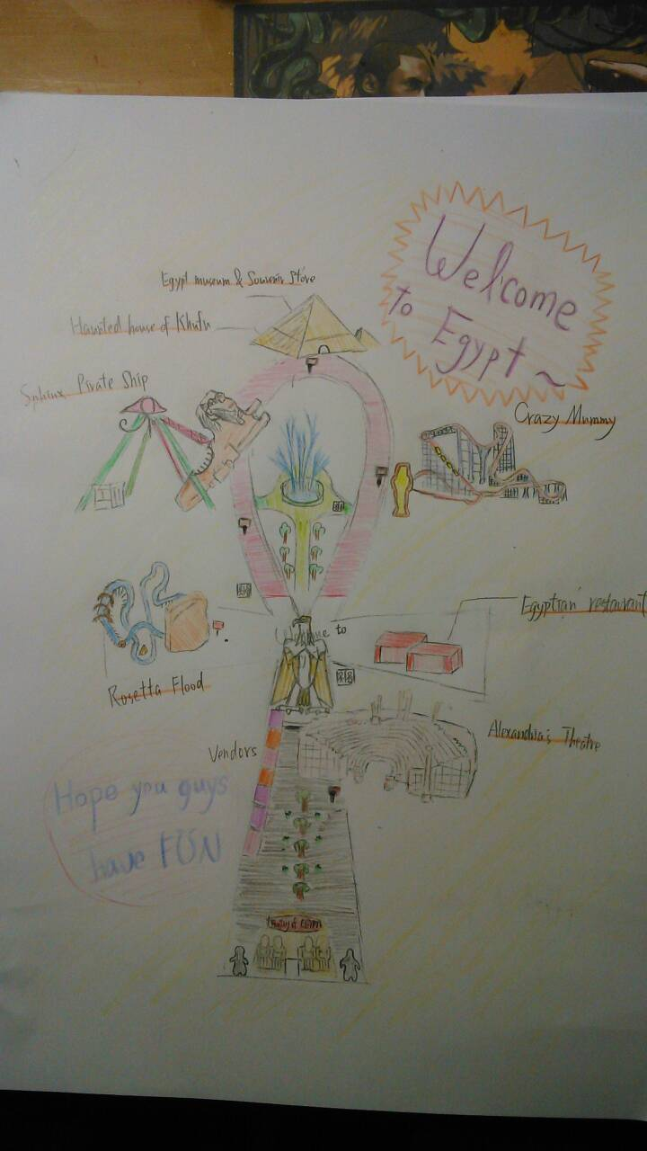
Map

Slide 3
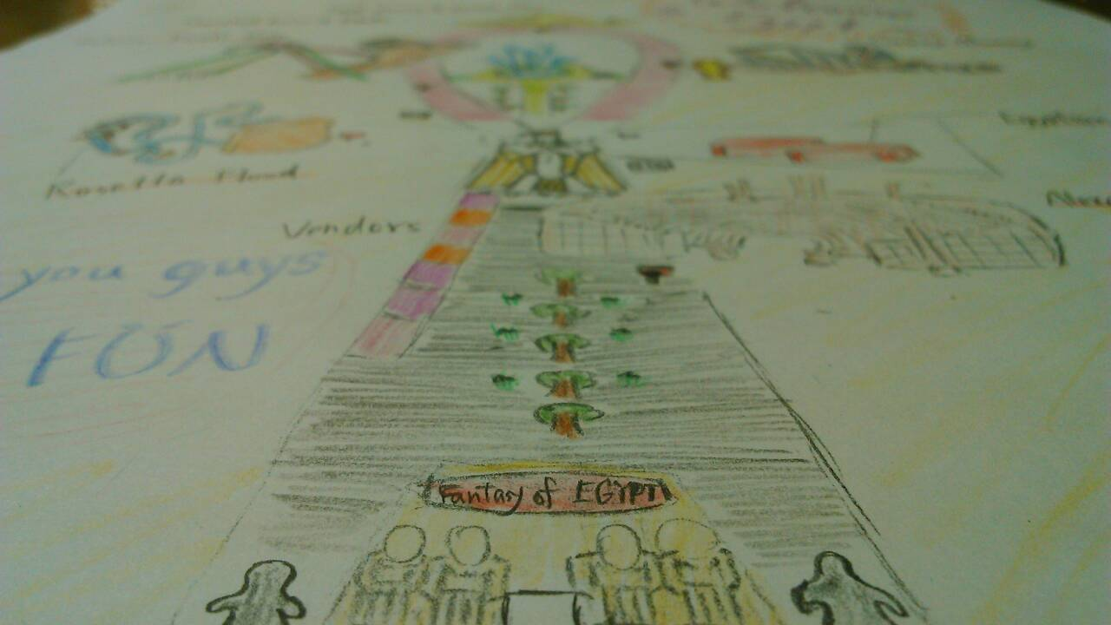

Slide 4
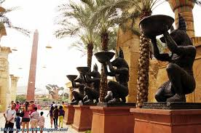
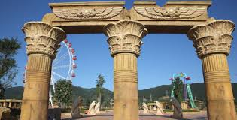

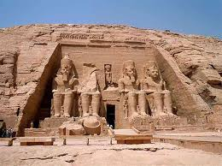
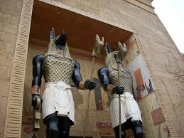
Let’s Go

Slide 5
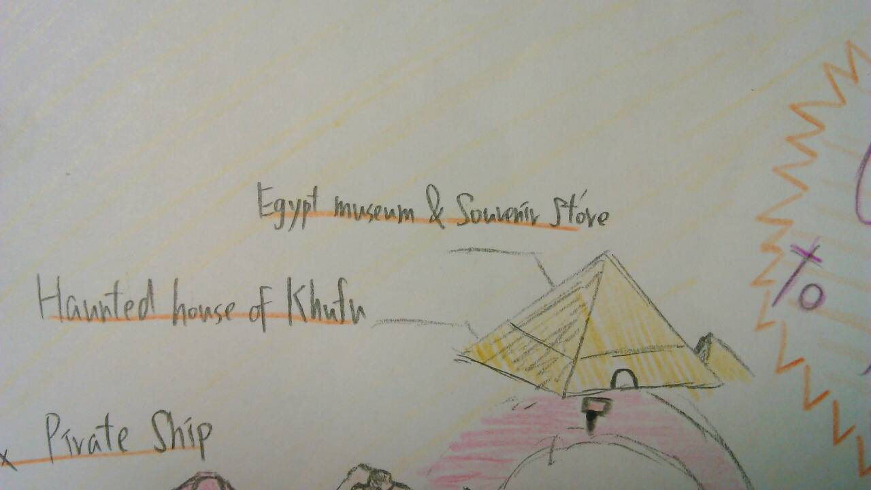

Slide 6
Khufu
Khufu pyramid
Here is composed of three parts. One is haunted house, another is Egypt museum, the other is souvenir store.
  Souvenir store
  You can buy many souvenirs to send your friends and families. There are bags of sphinx, cups of pyramid, notebooks, postcards, and dolls.

Slide 7
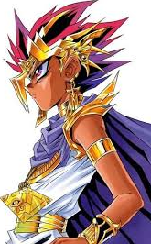
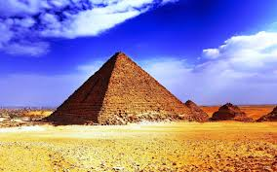
Khufu
Haunted house of Khmu
There is your best choice to experience. In there, you must through many
Egypt museum
There are many Egypt antiques like as sphinx pattern, pyramid pattern, or Egypt’s history books.

Slide 8
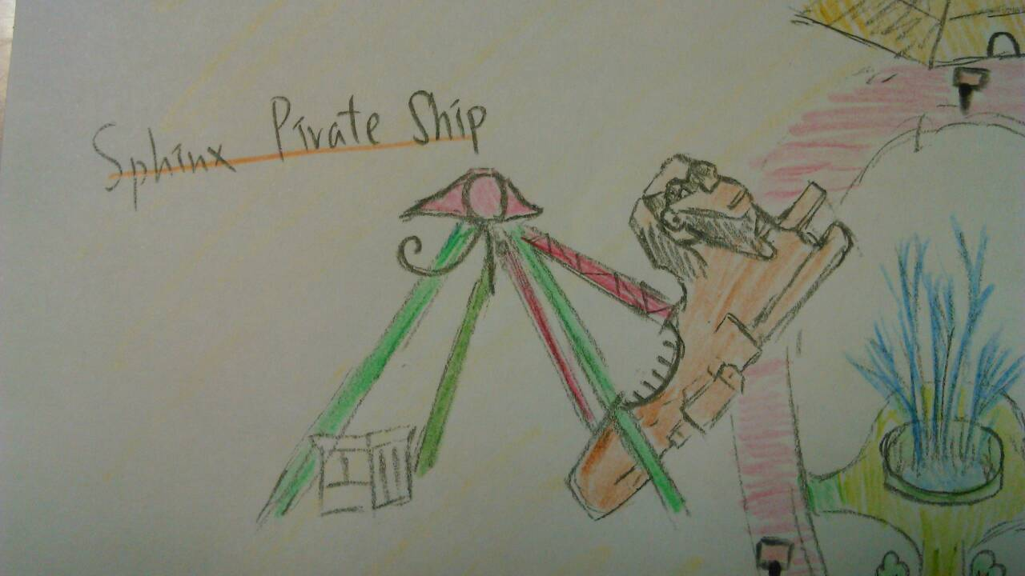

Slide 9
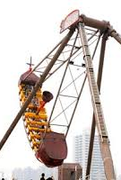
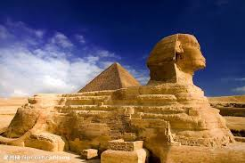
Sphinx Pirate Ship
This pirate ship is designed to the shape of Sphinx and it is painted orange .
Just like the real Sphinx . It can swing almost perpendicular to the ground .

Slide 10
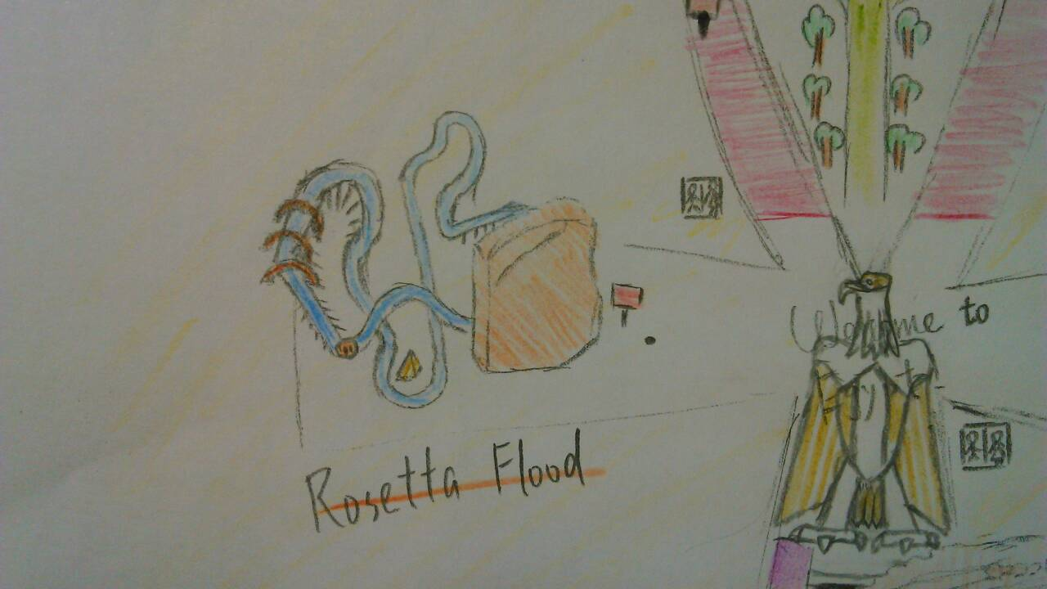

Slide 11
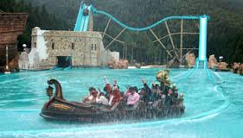
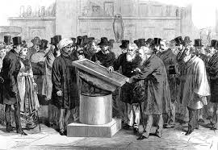
Rosetta Flood
This facility is 85 km / h. Thus, it will allow you to experience what is called “SPEED”! Are you ready to have fun? Remember to wear raincoat for fear of getting wet !

Slide 12
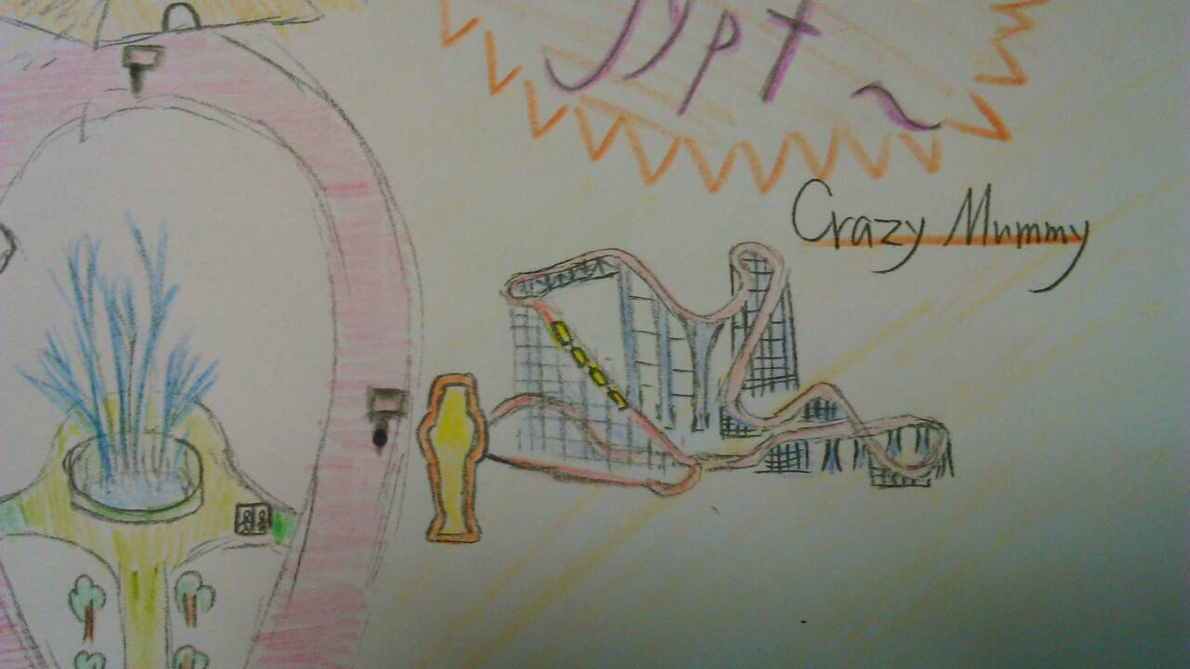

Slide 13
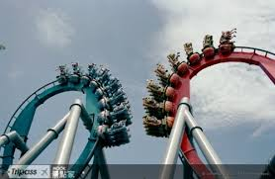

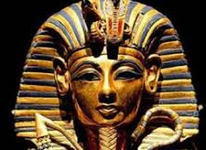
Crazy Mummy
Get ready for the strong G Force by the pressure of the climb, so as the 360-degree loops.

Slide 14
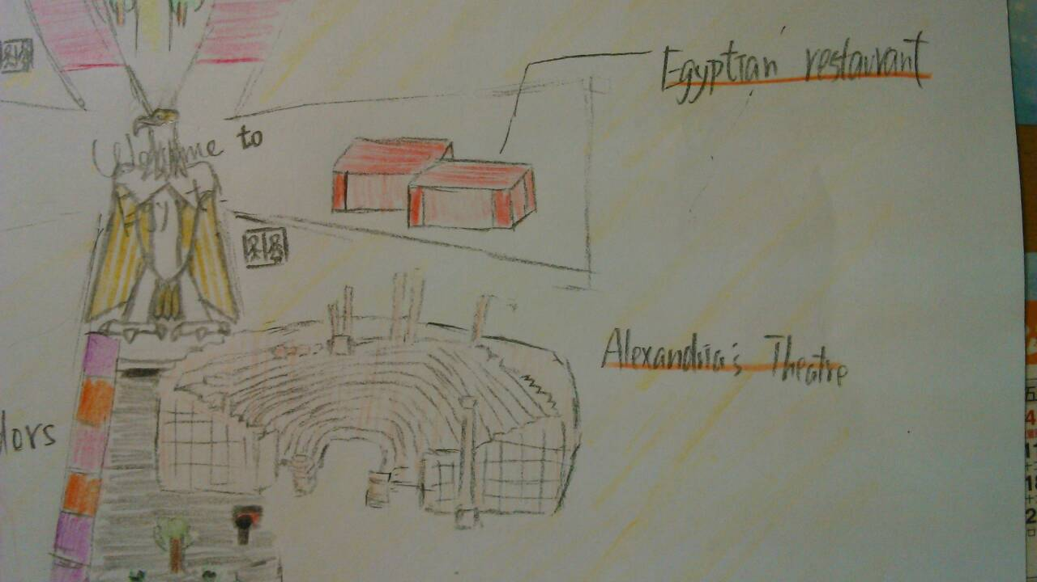

Slide 15
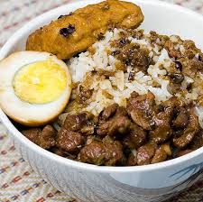
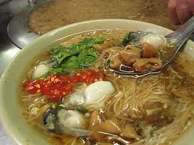
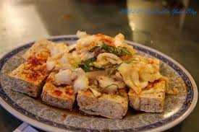
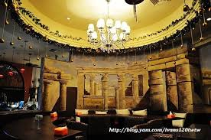
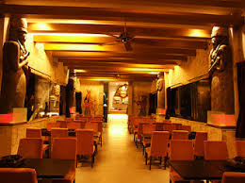
Restaurant
Come to our restaurant to satisfy your desire .

Slide 17
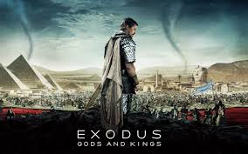
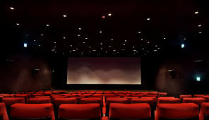
Alexandria Theater
This movie is a retelling of the epic story of Moses. You will return to the Ancient Egypt again to have another adventure.

Slide 18
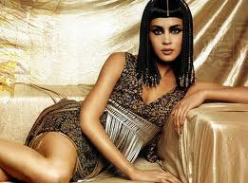
The End
To sum up , it is an educational place for people to visit.
I will wait for you~~~~

Slide 19
組員: 2號黃俊翔
6號葉子豪
14號許智揚
15號黃譯文

