Slide 1
B U S S O N E Y
The greatest amusement
in the world
Group Member : 1、7、10、13

Slide 2
Information
Business time : Sunday to Friday
A.M.9~P.M.9
Closed : Saturday
Adult : 200NT
Child : 100NT
Under 120cm : Free
Telephone : 0800-68-0674

Slide 5
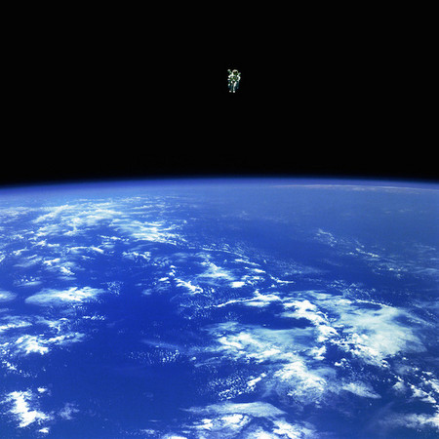
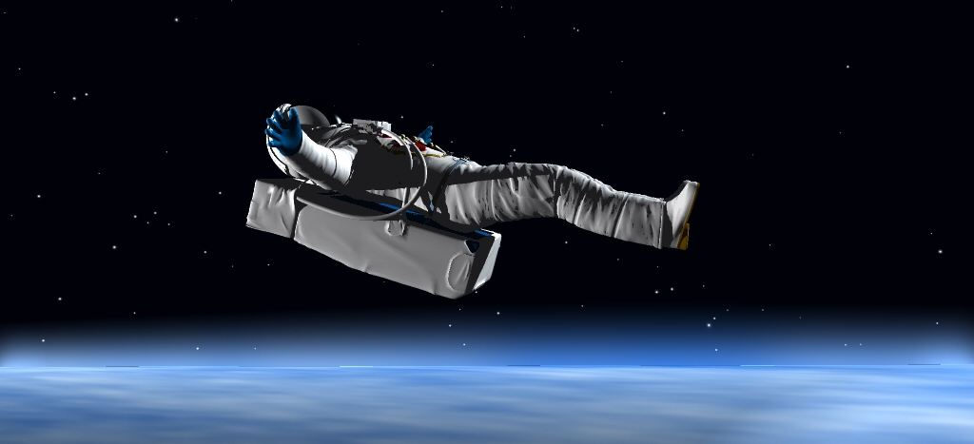
Weightless Zone
It would let your physical feel relaxed. you don't need to go to outer space but can enjoy the pleasure of this.

Slide 7
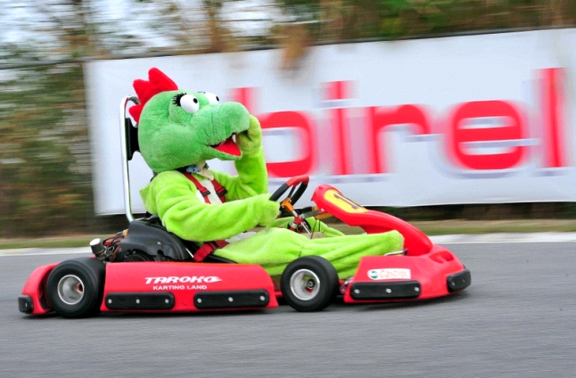
Dinosaur Kart
This is a place to drive karts.
You can see many species of dinosaur images in front of you, then you can pick your favorite.
Kart YA!

Slide 9
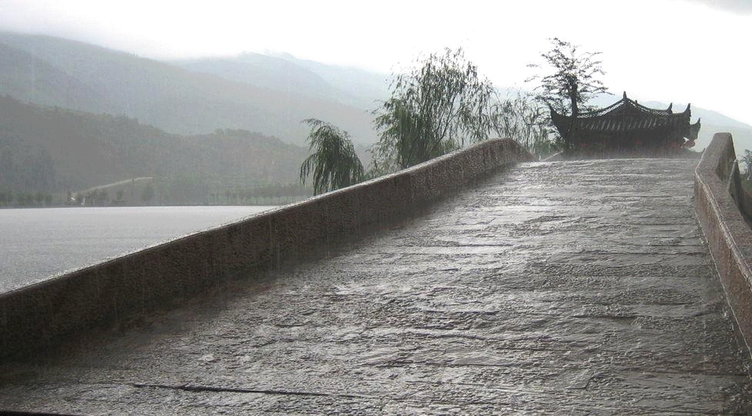
Athletic Food Street
It would content your stomach
It would amaze your tongue
All of foods here would take you to the paradise

Slide 11
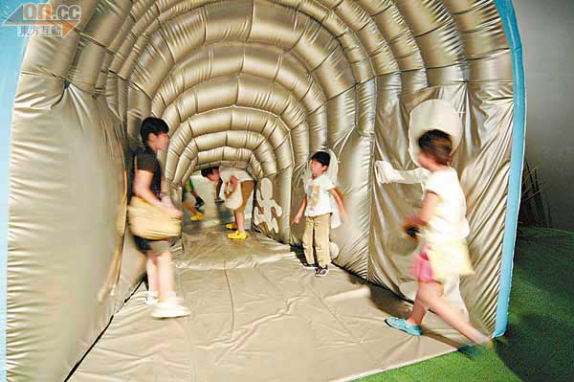
Miniature Wonderland
the special design must let you feel latest.
If you want to get the stimulation of the huge creatures surrounding welcome!

Slide 13
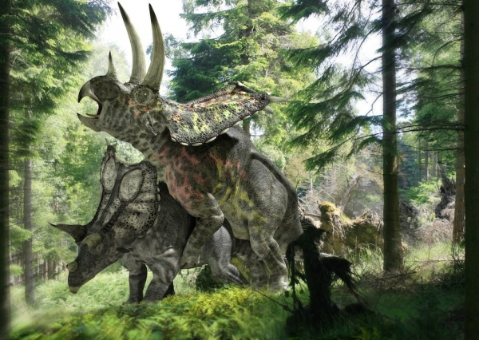
Forest of dragon(Jurassic park)
This is a forest that is full of the dinosaur .
Be full of various rare dinosaurs to wait for you in the Jurassic park.
Dinosaur

Slide 14
What Are You Waiting For?
??

Slide 16
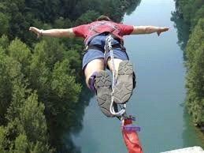
Bungee Jumping
The hight of this is 200m
The stimulation here are limitless
Don‘t! forget tie the rope on your ankle
JUMP!!

Slide 18
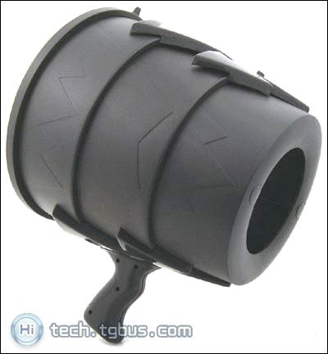
Air Gun
this facility is through the special tube that transmit you to anywhere you want.
空気砲!

Slide 20
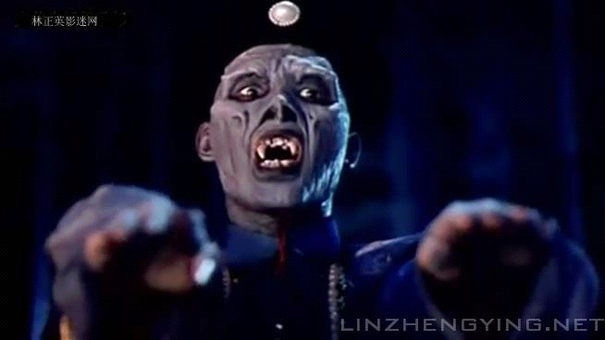
Zombie House
Open your eyes
Brace your mind
Stop your breath!!
Ahh…

Slide 22
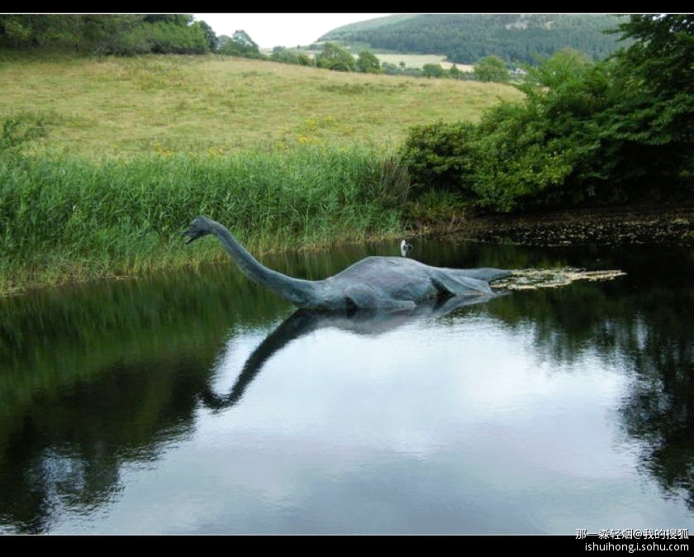
Scenery of Loch Ness
Several rivers and lakes train the ocean, in such a under water world ,you can view the lands cape under the sea carefree and without worries ,in such a Loch Ness dressing ,which has more ancient feeling , attract you to appreciate deeply.

Slide 24
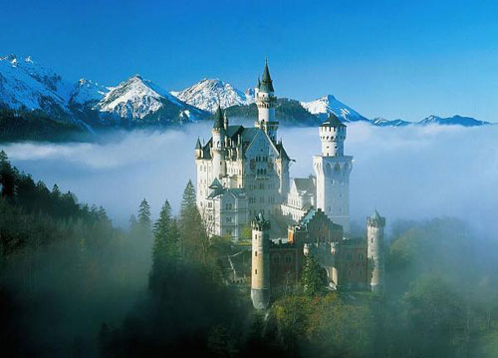
CASTLE
Whatever you want !
Whatever you need !
It will be found in the castle !
If you want. All your dream in the castle will come true!

Slide 25
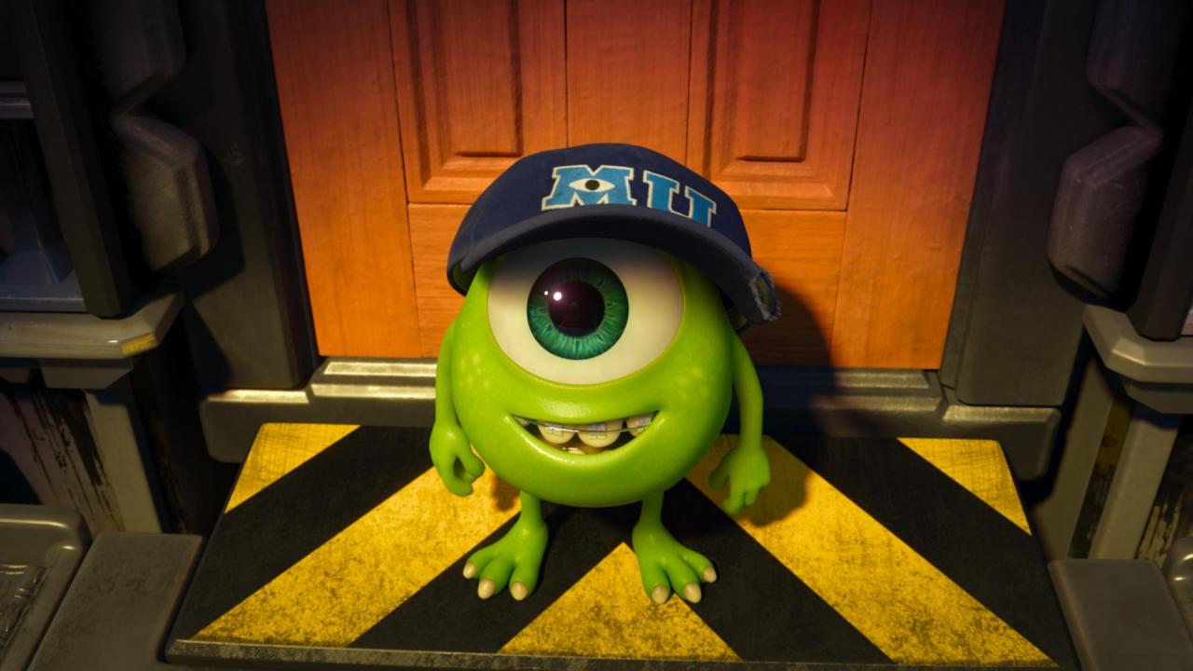
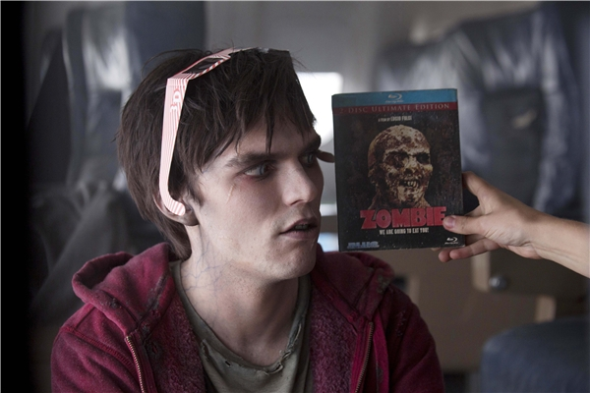
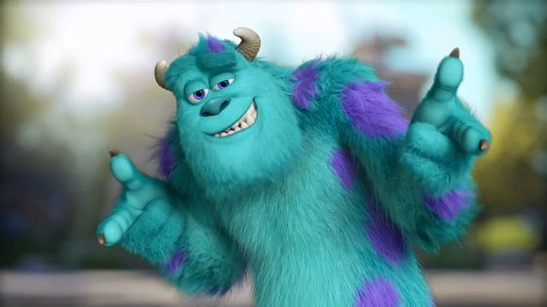
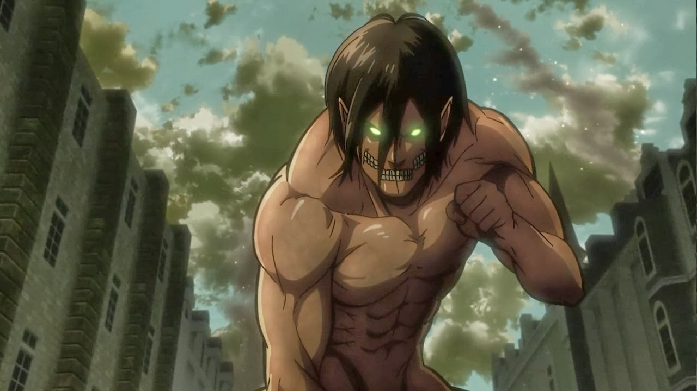

Slide 26
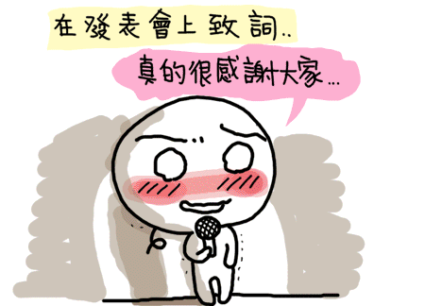
THANKS FOR WATCHING!!
Hope you can visit “Bussoney” again!

